Slide 1

D3.js
CMPT 384 – Information Visualization
Lab 9
Course Instructor: Debajyoti Mondal
Lab Tutorial Instructor : Arman Heydari ( arman.heydari@usask.ca )

Slide 2
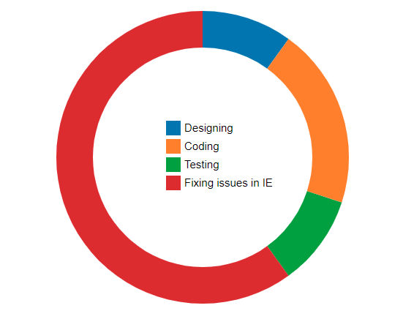
Agenda
D3 Scale (Ordinal)
D3 Generator (arc)
D3 Color Scheme
D3 Layout and Examples
D3 Pie Chart
Chart Legend
D3 Force Layout
D3 Drag function
D3 Force Strength Panel

Slide 3
D3 Scales – Ordinal Scale
var color_bucket = d3.scaleOrdinal() .domain([‘A’, ‘B’, ‘C’])
.range([‘Red’, ‘Green’, ‘Blue’])
>> color_bucket(‘A’)
>> ‘Red’
>> color_bucket(‘C’)
>> ‘Blue’
A
B
C

Slide 4
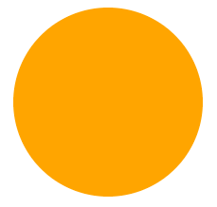

D3 Generator (Arc)
d3.arc()
.innerRadius(0)
.outerRadius(100)
.startAngle(0)
.endAngle(Math.PI * 2)
Angle in Radian ; Math.PI = 180 degree
0 degree
innerRadius = 60
outerRadius = 100
startAngle = Math.PI/2
endAngle = 3/2 * Math.PI
270 degree
90 degree

Slide 5
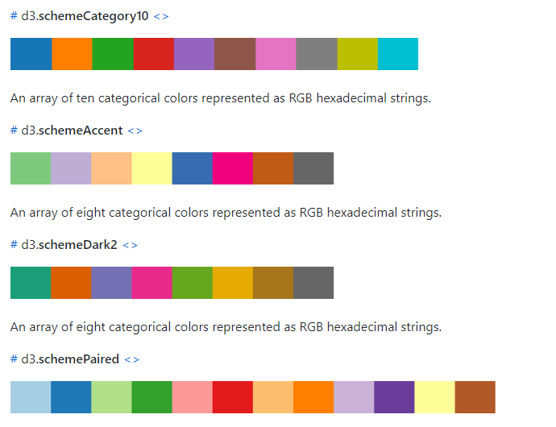
D3 Color Scheme
https://github.com/d3/d3-scale-chromatic/blob/master/README.md

Slide 6
D3 Layouts
Layouts in D3 are special built in functions that transform your data points for advanced visualizations like tree maps and network graphs.
Layouts however do not directly create charts.
They only augment your datasets with additional values (visual variables) such as position and size.

Slide 7
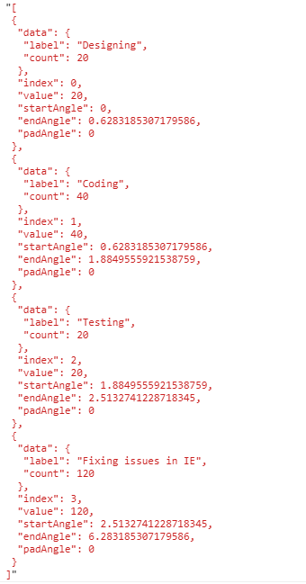
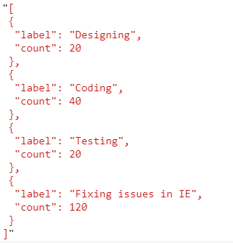
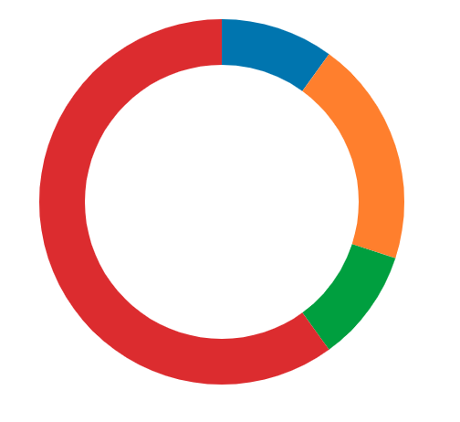
Example Layout for Pie-Chart
Layout output converted into graphics with generator
Initial Dataset
Dataset after applying layout

Slide 8
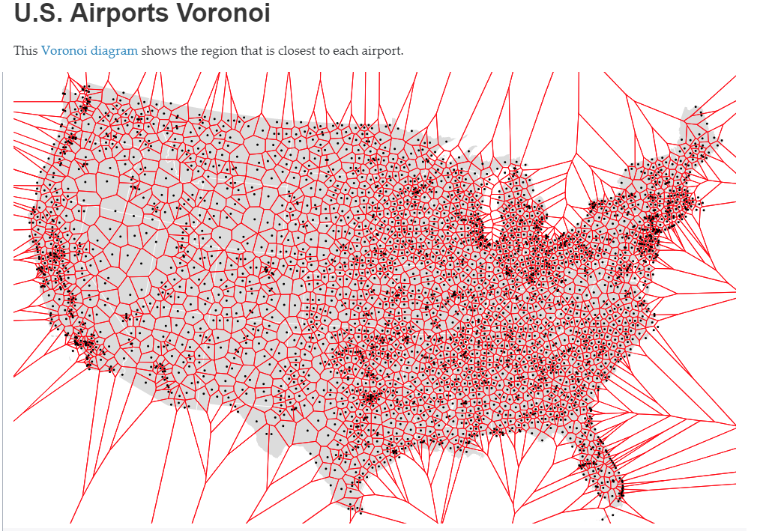
https://github.com/d3/d3-voronoi

Slide 9
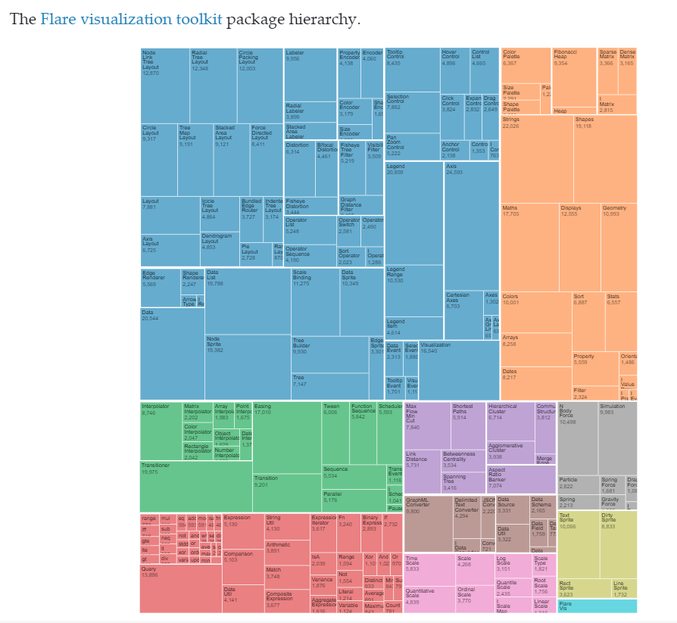
https://github.com/d3/d3-3.x-api-reference/blob/master/Treemap-Layout.md

Slide 10
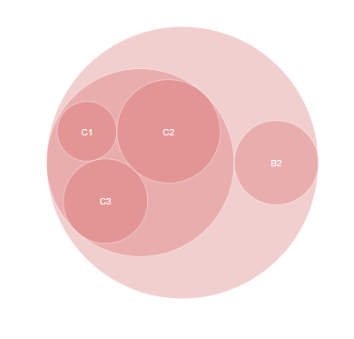
https://github.com/d3/d3-3.x-api-reference/blob/master/Pack-Layout.md
Image reference - https://d3indepth.com/layouts/

Slide 11
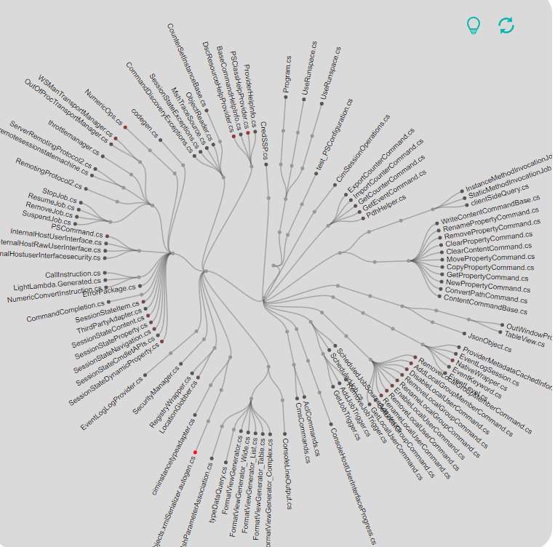
Image reference - https://clone-swarm.usask.ca/
Info - https://d3-wiki.readthedocs.io/zh_CN/master/Tree-Layout/

Slide 12
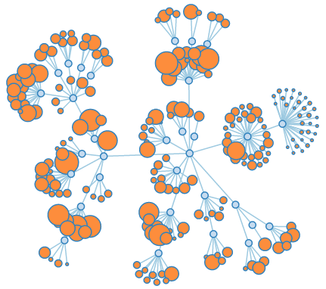
https://github.com/d3/d3-force

Slide 13
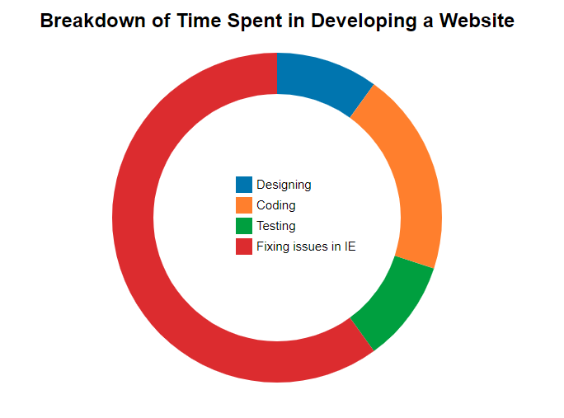
Example – Pie Chart

Slide 14
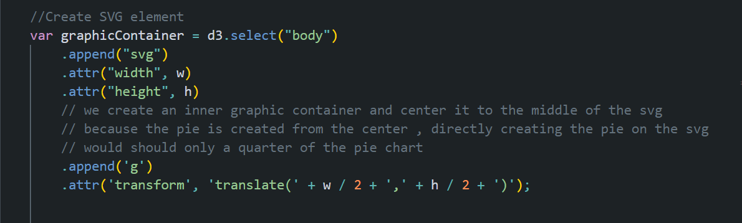
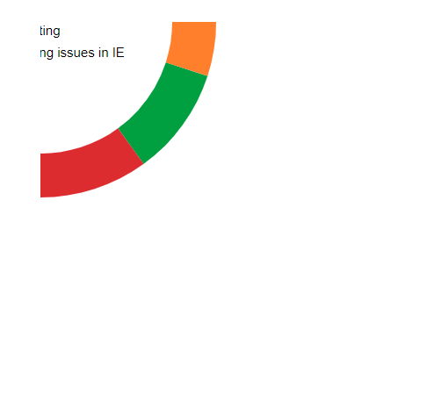
Example – Creating the Container
Create the actual graphic inside an inner container and then center the inner container in the middle of the SVG.
This way we transform the center of the graphic to the center of the SVG instead of top left corner.

Slide 15
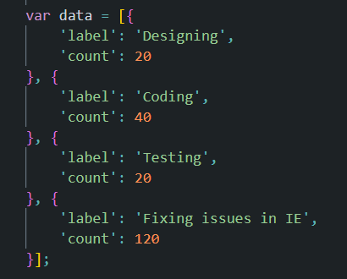
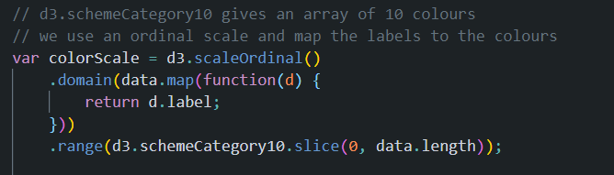
Create a color scale for the data
10 Basic Colors in D3 scheme Category 10

Slide 16
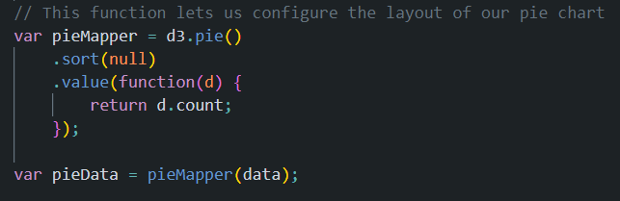
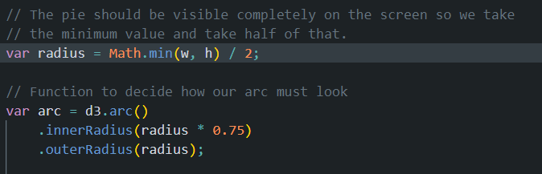
Configure Pie Layout and Arc Layout
Since we don’t want any sorting the sort function is set to null .
The angles of the pie are calculated based on the count value and so an accessor function for the same must be passed in.
The pie chart needs to be visible on the screen without any clipping so we set the radius based on the minimum value.
Since we are creating a doughnut chart the inner radius is set to ¾ of the radius.
If we set the inner radius to 0 the chart is completely filled in. GIVE IT A TRY !

Slide 17
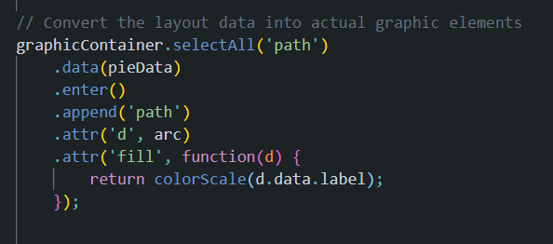
Generate Path Elements

Slide 18
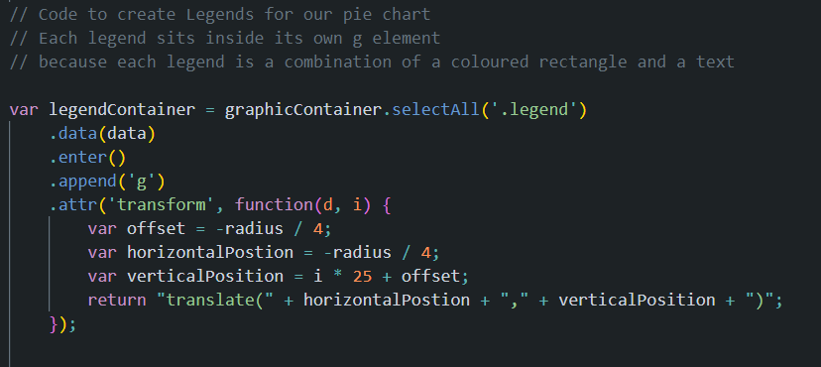
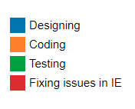
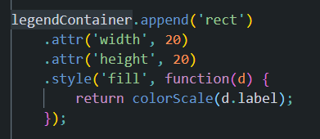
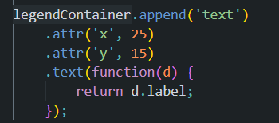
Chart Legends

Slide 19
D3-Force
D3-Force is an inbuilt module for simulating physical forces on particles.
The D3- Force module provides a layout for positioning visual elements based on a combination of different forces.
For Example if we had a couple of circles , the types of forces could be :
Attraction Force – All circles are clumped together
Collision Detection Force – Circles do not overlap each other
Gravitational Forces – All circles are forced towards a center of gravity
Linked Forces – Circles are equidistant or fixed distance apart like in a network.

Slide 20
Steps in Setting up a Force Simulation
Modify the data into the required format – an array of objects (nodes)
Pass in the data to the force simulation layout , by calling the function forceSimulation.
Define the various types of forces acting on the nodes using the different kinds of default force functions present in d3 like forceManyBody , forceCenter and forceCollide
Update the attributes of the visual elements in the tick function as it is called each time the simulation iterates.

Slide 21
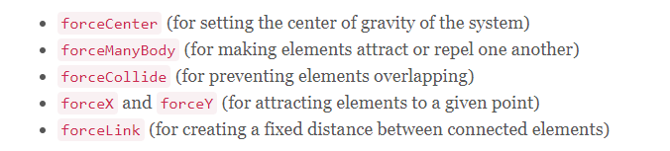
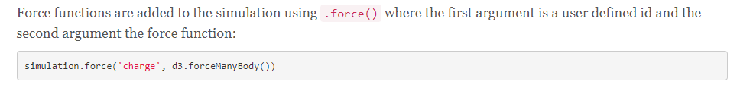
Built in Force Functions
https://d3indepth.com/force-layout/

Slide 22
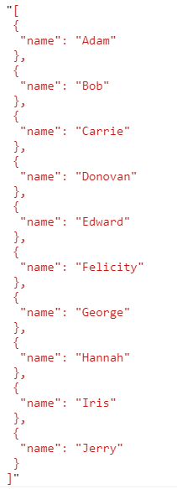
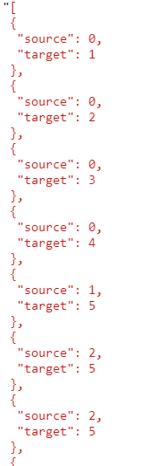
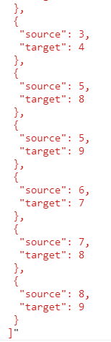
Input Data
Nodes
Edges

Slide 23
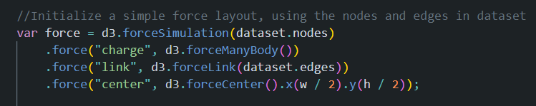
Setup Force Simulation
forceManybody has a default strength of -30 , negative indicating that the force is repulsive , so this force ensures that nodes are not overlapping one another.
The forceLink force holds the node togethers and ensures that nodes move relative to one another
The forceCenter force centers the nodes towards the center of the SVG.

Slide 24
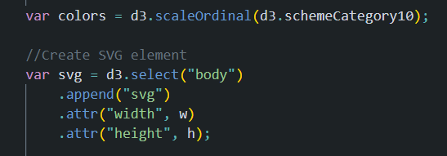
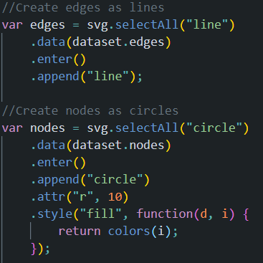
Create Visual Elements
Note that the visual elements don’t have any positions set as of yet.
They are only created and added to the webpage.

Slide 25
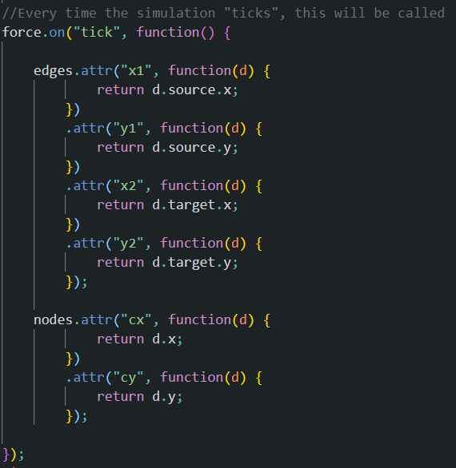
As the Simulation Iterates – Set the positions
Nodes are circles so their cx and cy are set thus
positioning the circles based on the force.
Edges are lines drawn between two points
(x1,y1) and (x2,y2)
As the simulation ticks these values are continuously
updated creating the smooth effect of animation of
nodes moving and colliding with one another.

Slide 26
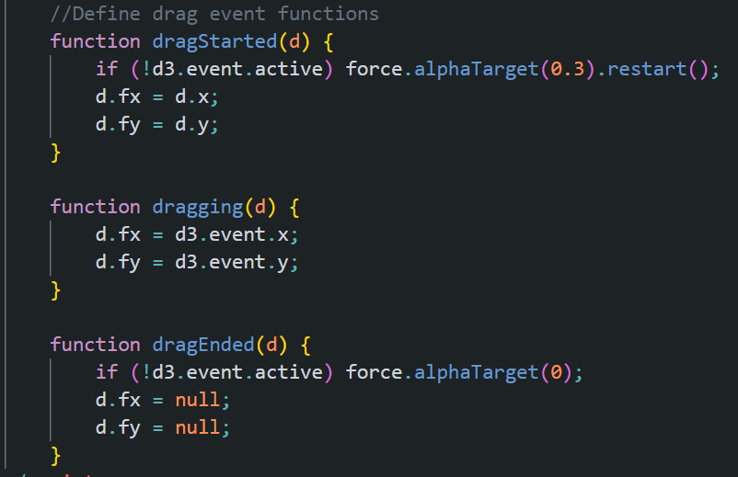
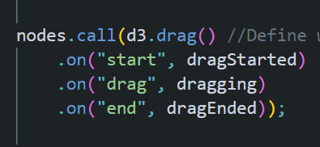
Dragging Effects

Slide 27
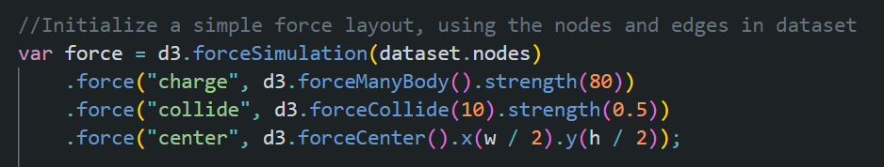

Other kinds of Layouts
Changing the initial set of forces that define the simulation changes the way in which the nodes are laid out and move.
For example in the dragging layout html file , modify the force simulation to the code snippet below -
The strength in the forceManyBody is positive so the nodes are pulled towards each other
While the forceCollide prevents the nodes from overlapping by giving a repelling force.

Slide 28
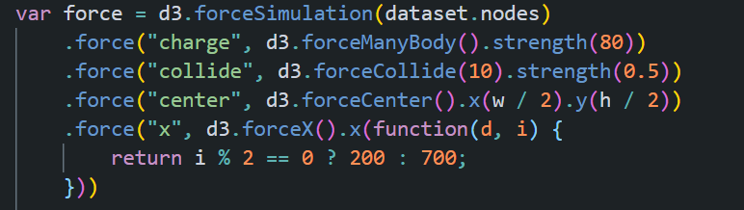

Other kinds of Layouts
We can also separate the nodes into two groups.
For this we can play around with the centering force where we force the centerX of all even numbered nodes to one X position 200 and all odd nodes to another position 700.

